Slide 1
DOM Manipulation

Slide 2
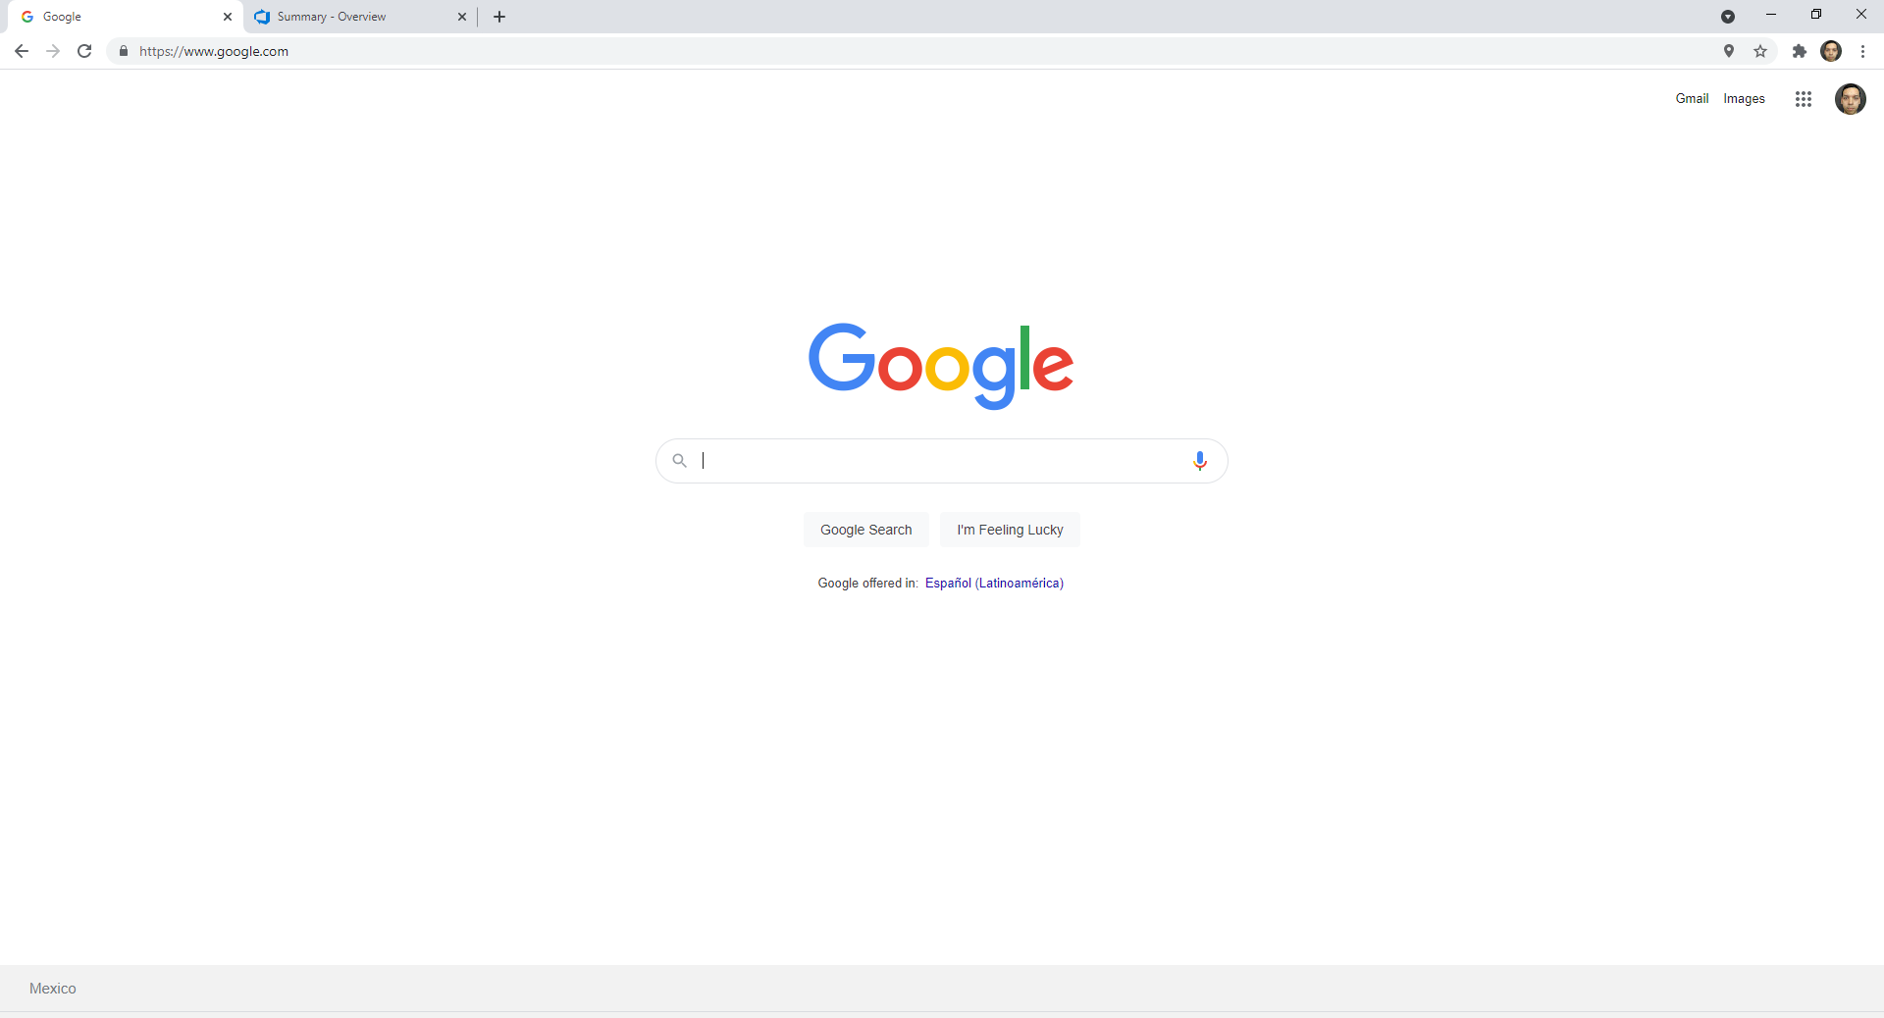
Main sections of a browser
Navigator
Window
Document

Slide 3
Main sections of a browser
The navigator represents the state and identity of the browser.
Retrieve user's preferred language
Retrieve media stream from the user's webcam
The window is each of your browser tabs and contains a web page loaded.
Modify window size
Navigate back and forth using the history object
Store data using any of the available storage mechanisms
The document currently loaded in each one of your browser tabs is represented by a DOM document object model.
Manipulate information on the HTML and CSS
Element CRUD

Slide 4
DOM – Document Object Model
This is a "tree structure" representation created by the browser that enables the HTML structure to be easily accessed by programming languages
Browser itself uses it to apply styling and other information to the correct elements as it renders a page
Developers like you can manipulate the DOM with JavaScript after the page has been rendered.

Slide 5
Nodes
Element node: An element, as it exists in the DOM.
Root node: The top node in the tree, which in the case of HTML is always the HTML node.
Child node: A node directly inside another node.
Descendant node: A node anywhere inside another node.
Parent node: A node which has another node inside it.
Sibling nodes: Nodes that sit on the same level in the DOM tree.
Text node: A node containing a text string.

Slide 6
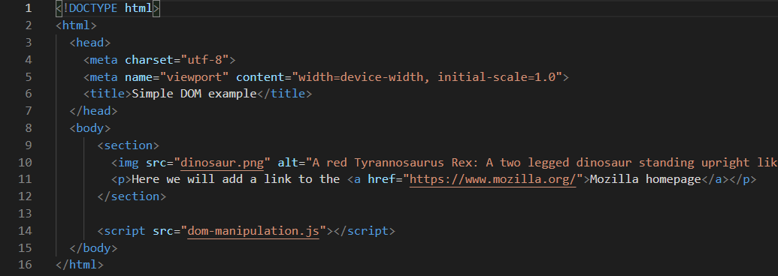

Slide 7


Selecting nodes
To manipulate an element inside the DOM, you first need to select it and store a reference to it inside a variable
Select many elements using querySelectorAll()
Allows using CSS selectors

Slide 8



Creating nodes
To create a node, first select the node which will contain the new node. This is the parent node.
Create the node using document.createElement()
Append newly created node to its parent node.

Slide 9



Deleting nodes
Using self reference (modern way)
Using parent and child references
Using self reference in older browsers

Slide 10
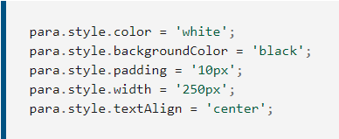

Manipulating styles
Adding inline styles
Adding attributes

